Slide 1

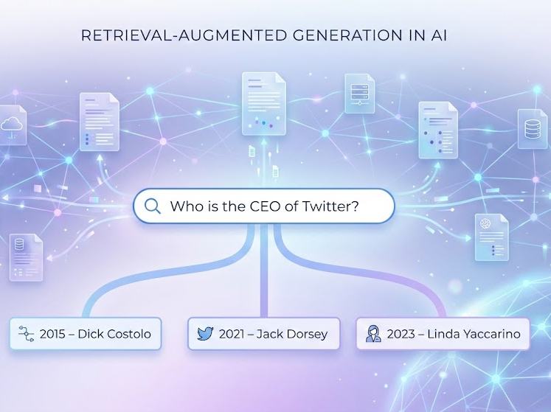
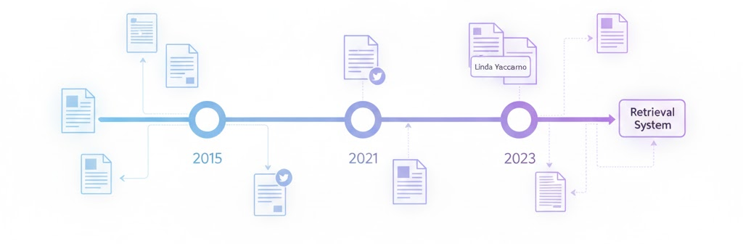
Time Aware Retriever - Injecting Temporal Information using Negative Hard Mining
[Group 11]: Sonith Bingi, Manoj Arulmurugan, Prasad Jawale, Gauri Patki

Slide 2
The Temporal Gap in RAG Systems
Problem & Objective
Standard RAG treats knowledge as static.
Enable retrieval systems to respect temporal validity and retrieve information appropriate to the query's time.
Current Failure Modes:
Temporal Hallucination: Retrieving the most popular entity (e.g., Jack Dorsey) regardless of the query date.
Right Fact, Wrong Time: Retrieving a 2014 World Cup document for a 2010 query due to high keyword overlap.
For Example:
Query: "Who was the CEO of Twitter in 2021?"
Expected Answers according to the year:
2015: Dick Costolo
2021: Jack Dorsey
2023: Linda Yaccarino

Slide 3
Existing Works & Limitations
Contriever
Method: Retriever ptimized for semantic similarity. It completely ignores time and struggles with dynamic facts.
TempRetriever / BiTimeBERT
Method: Concatenate explicit time vectors/tokens to embeddings.
Limitation: Metadata Dependent. Fails on unstructured web text (e.g., Common Crawl) where metadata is missing or unreliable.
Standard Modular RAG
Method: Separate modules for retrieval and re-ranking.
Limitation: High Latency. Relies on LLMs to summarize every retrieved document before ranking, making it too slow for real-time use
Our goal is to build an implicit time-aware retriever that does not require metadata and supports low-latency re-ranking.

Slide 4
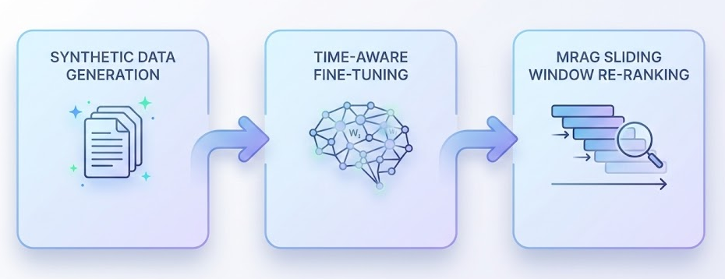
3-Stage Time-Aware Pipeline
Stage 1: Synthetic Data Generation
Source: FineWeb-Edu (500k passages).
Process: Used T5 to generate 15,000 "temporally anchored" questions (e.g., "What happened in 1999?") conditioned on explicit years found in text.
Stage 2: Time-Aware Fine-Tuning
Novelty: Temporal Hard Negative Mining. Form (Ques, Pos, Neg) Triplets
Mechanism: Anchor: Query (Target Year: 2010).
Positive: Document matching 2010.
Negative: Document semantically identical but from 2014.
Loss: Margin Ranking Loss pushes the "Wrong Time" document away in vector space.
Stage 3: Integration with MRAG
Question decomposition into Semantic Main Content (MC) and Time Content (TC)
MRAG Reranking Hybrid Score = Product of Semantic and Temporal Score
  Replaced slow LLM summarization with fast windowing on the whole passage for Cosine Similarity Calculation
  Temporal Score ∝ Distance between Passage Date and Question Date

Slide 5
Models & Baselines
Base Contriever (Baseline)
Pre-trained facebook/contriever-msmarco.
Time-Aware Contriever
Our fine-tuned model trained on T5 synthetic data.
Uses Temporal Hard Negatives to learn time sensitivity.
MRAG (+Base Contriever)
Base Contriever + Sliding Window Re-ranker.
Ablation: Tests if re-ranking alone solves the problem without fine-tuning.
MRAG (+Time-Aware Contriever)
The Full Pipeline.
Combines the Fine-Tuned Retriever with the MRAG Re-ranker.

Slide 6
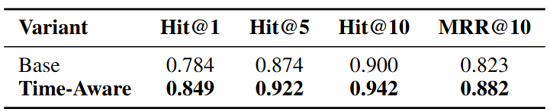
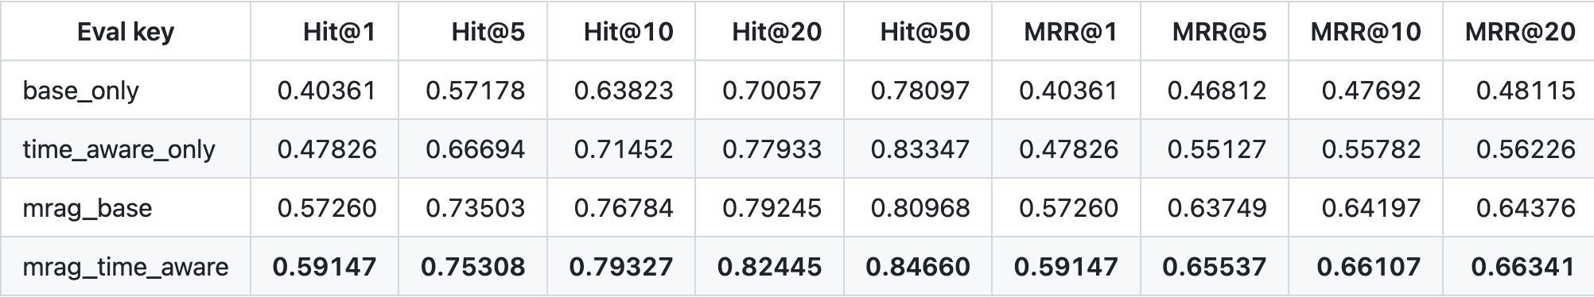
Evaluation on Historical Data (ChroniclingAmericaQA & T5)
Metric: Top-K Accuracy (Hit@1,5,10, 20,50) and Mean Reciprocal Rank (MRR@1,5,10,20) on In-Domain and Out-of-Domain Data
Key Analysis:
Fine-tuning Generalizes: The model learned "time" from modern web data and successfully applied it to historical newspapers (1789-1963).
Time Aware Contriver does a better job of getting the initial passages using the full question (MC + TC)
MRAG’s Hybrid score-based Re-Ranking works
In-Domain Results (T5 Test Set)
Out-of-Domain Results (CAQA)
Out-of-Domain Results (CAQA)

Slide 7
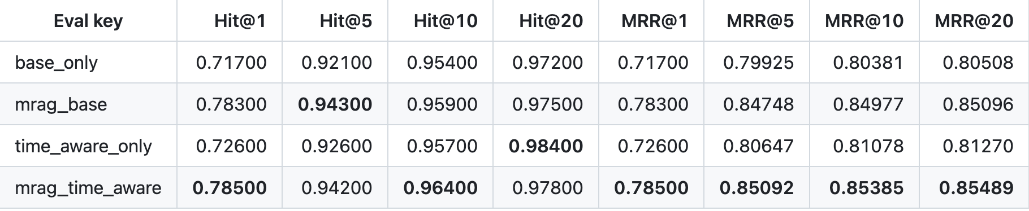
Evaluation on SQuAD (Temporal Questions)
Metric: Top-K Accuracy (Hit@1,5,10) and Mean Reciprocal Rank (MRR@1,5,10) on Temporal SQuAD
Key Analysis:
Base Competence: The baseline Contriever is already strong on SQuAD (Hit@5 = 0.921), likely due to overlap with Wikipedia pre-training data.
MRAG Gains: Re-ranking improves Hit@5 to 0.942/0.943, showing that MRAG still benefits ranking even in clean encyclopedic domains.
Time-Aware Fine-Tuning: Smaller relative gain compared to CAQA, indicating the temporal fine-tuning is most useful for noisy or historical data.

Slide 8
Conclusion & Future Work
Summary:
Successfully injected implicit temporal reasoning via contrastive fine-tuning (no metadata tags required).
Sliding Window MRAG enables efficient, time-aware re-ranking using a hybrid without the latency of generative models.
Future Work:
Implicit Temporal Reasoner: We plan totrain a lightweight cross-encoder capable of inferring time intervals from context without relying on explicit digits Eg: “Post WWII”
End-to-End RAG: We aim to close the loop by integrating a generative reader (e.g.,Llama-3) to evaluate end-to-end Exact Match (EM) scores.
  Allows us to verify if better retrieval ranking directly translates to more accurate final answers for the user, rather than just improved recall metrics.

Slide 9
Thank You!
Questions?

